Slide 1
Unity 3D “Bullet Hell”
Parker Holt, Jinxiao Yu, Dylan Rainwater, Jacob McLemore

Slide 2
Introduction
Technology Used
Unity / C#
Free assets from the Unity store
Inspiration
All of us were either gamers or developers who wanted to start becoming familiar with game design
Challenges
Unfamiliarity with game development
All of us had pretty strong course loads

Slide 3
Overview
Randomly generated map for a unique playthrough every time
Map is separated into chunks that always load and unload off-screen
User unlocks “spells” for a more interesting combat system
Also can upgrade health, mana, and damage
Mana can be used to cast unlocked spells and will slowly regenerate
Spells can be used to enhance mobility or add variation to attacks
If the user is hit by an enemy’s spell, health will be lost until upgraded
Enemies get progressively more difficult over time
The game continues until the user’s health bar is drained

Slide 4
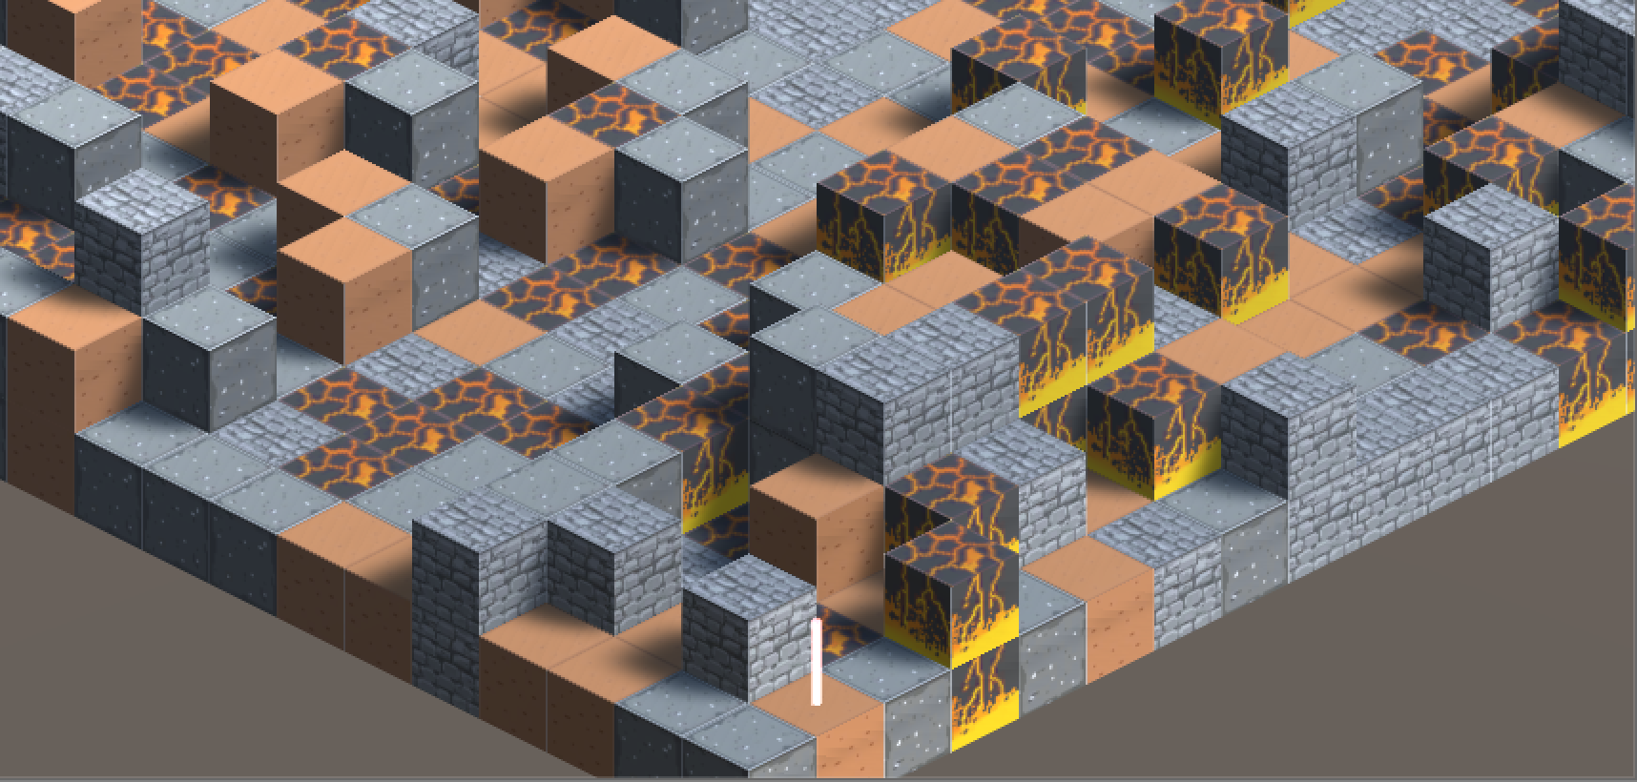
OLD IDEA

Slide 5
Future Work
Unique Art Assets
More Upgrades
Difficulty Levels
Enemy Variation
Code Refactoring
Multi-platform

Slide 6
Challenges
Not very much video game development experience
RPGs are massive and we had a short deadline
Last-minute change from RPG to “Bullet Hell”
CS 360

Slide 7
Customer Value
Provides entertainment for those who are easily entertained (canis familiaris)
Highly volatile customer value
Like any indie game, it truly is unknown until it is launched
After further development, the best we can do is increase desire to play

Slide 8
DEMO!

